Slide 1
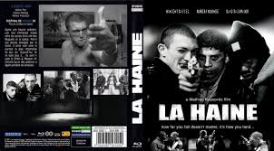

Movie Review: La Haine

Slide 2
Synopsis
La Haine (Hate) is a French-based movie
Directed by Mathieu Kassovitz in 1995.
A Multiracial movie involving Blacks and Arabs fighting against ruthless White police force.
It depicts the fight for racism and brutality among the French authorities.
Notes:
The movie reflects the oppressive times that occurred twenty years ago, and reveal that the dark history has replicated itself in the modern France. The film entails three young men who spent most of their time in the French suburbs, as La banlieue, informally one of the French ‘Ghettos’. The storyline of this movie entails racial discrimination, violence, brutal killings and disgraceful actions. Specifically, it revolves the fight of different discriminated raced again the police. The French suburbs is full of racist and ruthless soldiers who discriminates the external races of colour (Vincendeau, 2005).

Slide 3
Synopsis continuation
Involves three parts:
At the French suburb (La banlieue).
In the Paris city
Back to the (La banlieue).
Each part is full of brutality
Elements of racism expressed too

Slide 4
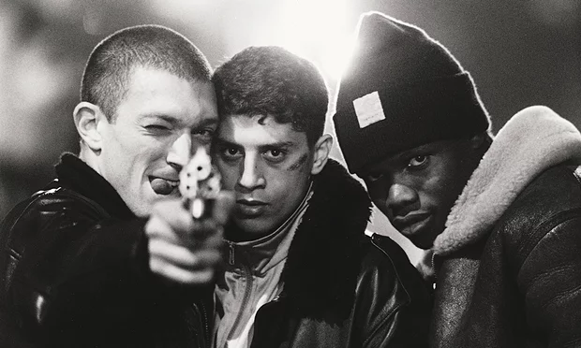
Main characters
Notes:
Left-right: Vinz (Vincent Cassel), Said (Said Taghmauli), Hubert (Hubert Kounde)

Slide 5
Main characters
Vinz (Vincent Cassel),
Jewish and portrays himself as a very outrageous man.
Hubert (Hubert Kounde)
African –French black boxer
Clever, quiet and Philosophical
Once a drug dealer
Notes:
Vinz is Jewish and portrays himself as a very outrageous man. He is a self-proclaimed criminal as he killed the police officer. Hubert is an African –French black boxer who was once a drug dealer. He is the most silent and also the cleverest of the three. He has developed a phobia for living in the French ghetto and wishes to flee away from that violent area. However, he is not successful since lacks the mechanisms to achieve so

Slide 6
Main characters: Conti..
Said (Said Taghmauli)
An Arab Maghrebi
Vibrant
Funny maker
Does not like making his own decisions

Slide 7
Summary of the plot
At the French suburb (La banlieue).
In the Paris city
Back to the (La banlieue).

Slide 8
At the French suburb (La banlieue
Begins with the footage of riot at French estate
Abdel (Abdel Ahmed Ghili –friend to Vinz) arrested and brutally beaten and later hospitalized
Vinz vows to kill a policeman with a (gun acquired from a policeman, if Vinz dies
He nearly kills a policeman and escapes alongside with the associates; Said and Hubert.
Notes:
During the riots that erupted before the day a policeman lost his gun, Vinz was highly involved. He is responsible for grabbing the revolver from the policeman. When the Vinz obtains the gun he threatens to kill a policeman if his friend Abdel (Abdel Ahmed Ghili) dies in the hospital. Abdel is admitted in the hospital following the beating that were inflicted upon him while in the police custody.
After Vinz finds the revolver, he is becomes overwhelmed and he is accompanied by Hubert and Said where at several instances they find themselves under the dangerous side of the law. At some point, Vinz tries to kill a policeman who are appointed to stop the uprisings though he does not succeed. Following this action, the gang manages to flee and they quickly board a train when they plan to head for Paris.

Slide 9
At Paris
.The group visit a drug dealer and shots are fired
They are later nabbed by police though Vinz escapes.
Vinz hears the death of Abdel and threatens to kill the skin-head who did not flee
He is stopped by Hubert and frees the cop
Notes:
Following this action, the gang manages to flee and they quickly board a train when they plan to head for Paris. Nevertheless, they are held with many disappointments as they set their foot in Paris, since their interactions with the residents of Paris fuels hostility. Due to the chase by the policeman whom Hubert and Said has abused, the group end up lost I the final train and they spend their night in the shopping mall. During the next morning, the shocking news dawn to them that Abdel is dead. They become furious and they climb up to the rooftop as they throw racial insults to the police. Unfortunately, they come across the same group of racist French police officers who discriminated the immigrants. Sooner than later, these policemen embark on molesting Said and Hubert. Later, Vinzarrivs at the scene, and he holds the gun as he manages to scare away the policemen though one of the policeman remains adamant. Any time from then, Vinz is threatening to kill the policeman to quench his vengeance thirsty. Vinz decline to shoot the skinhead and submits the gun to Hubert. Hubert is the most silent of the three and very witty and due to this course, they let the police go unharmed. Vinz now believes that his dream for revenge is shuttered and loses his hope living in gangster life due to his pitifulness character

Slide 10
Return to the Ghetto…
The end of the drama film
Vinz is accidentally killed by a policeman
Hubert and the policeman then points guns at each other
voices uttering, “It all about society falling” are heard in the sound track

Slide 11
Racism in the movie
racial discrimination against Blacks and Arabs by the French authorities.
Vinz, , Hubert, Said racially insult the police.
Arresting of Abdel due to Riots
T]Vinz, , Hubert and Said, refer to policemen as racists anti-immigrants
Notes:
This is clear indication of the racial discrimination against Blacks and Arabs by the French authorities. This is depicted by the three main characters Vinz, a Jew, Hubert, a Black box and Said, an Arab. The group is furious with the racial segregation that is occurring in France. The policemen are termed to be show their racial element by brutally abusing the immigrants that are held in France. The three actors spent their life in La banlieue where in most of times they engage in fights against the French cops as they have come to a realization that their fellow immigrants are being segregated by the French authorities. More evidently, an uprising breaks up and one of the policeman loses the revolver which is taken by Vinz. Vinz threatens to kill the White skin head if the hospitalized Abdel dies. An element of racism comes out where the French authorities arrest and furiously beat Abdel until he sustains injuries. When the group receives the news that Abdel is dead they begin to racially abuse the policemen calling them racial anti-migrants skin heads (Elstob, 1997).

Slide 12
Lessons
We should not solve issues through violence
Peaceful ways are recommended to sensitize people nor to discriminate against colour
A good film for History and Theatre students
We learn how to be creative in plays, concerts and theatre performances

Slide 13
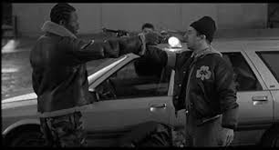
The end
Notes:
Video footage of Hubert and a cop after the Vinz is murdered.

Slide 14

End
My presentation is over

Slide 15

End

